Slide 1

Knock. Knock. Who’s there?
A message from the future
Notes:
Sometimes there are days I wish I could turn back time and undo some things to pretend they never happened. Almost like git rebase for time.
1927 a British astronomer called Arthur Eddington came up with a concept called “arrow of time”. The concept he posited described the time as unidirectional or asymmetric or always flowing in one obvious direction. But we don’t have to be fancy astronomers to grasp the concept of time
We all understand quite early in our life’s that time is constantly flowing in one direction and there is no turning back. Except when we implement time based business requirements we have a tendency to look back in time and believe that’s the only way to go.
Today I will take you through a journey of time and explore how traditional approaches sometimes fail, what alternatives we can leverage and how we can use durable timeouts to predict the future.
But first I have some shocking news for you

Slide 2

Business logic tends
to be complicated
Notes:
(click)
Thanks Captain obvious for this piece of advise
(click)
Jokes aside when working with clients I see people end up making the same kinds of mistakes repeatedly or more accurately the symptoms are the same.
The way that people make mistakes is very different each time so most of it has to do with business logic, so with regards to business logic.
I think it's fair to say that all of us in our systems have some kind of complicated business logic. But I want to talk about a specific kind.
The kind that involves both commands and queries.
So who is a part of their business logic: sometimes has to look up some additional data?

Slide 3
Hiding
Inconsistencies
Notes:
And it turns out that in that area that when you have your most complicated business logic, which often gives the business. The greatest value. That's where we actually have consistency problems that are hiding.
And this is irrespective of whether you're using Command and Query Responsibility Segregation (CQRS) or not.
Even if you're using a fully synchronous end to end architecture talking to a fully transactional relational database.
These things can bite you
So a lot of times everybody's heard about this eventual consistency.
you can go use it . Mongo web scale and all those kinds of things,
but a lot of organizations say, well, we'd rather Keep it safe and stay with the things that we know
I'm here to tell you is that even when you're using this safe architectural choices of doing everything synchronous even when you're using the safe technology choices like using SQL server. Oracle even then, sometimes you could end up with an inconsistent system.
These inconsistency problems get aggravated in multi user collaborative systems

Slide 4
Multi user collaboration
Notes:
The always on perpetually working your lots of users in parallel type of system has become more and more ubiquitous
users expect to be able to access their data. Whenever they want wherever they want and it's not just
each user by themselves. When you have a situation where you have users that are only operating on their own data.
Life is actually pretty simple I call those types of systems that are multi single user systems.
They're kind of like a multi user system, but each user's kind of in their own little data and that's it.
It's when users are able to touch each others data that things start to get even more interesting.
Now. Unfortunately, when we look at not just the technologies that we're dealing with, but the programming practices and the paradigms a lot of them are based on that same object oriented thinking Well, you write objects and you persist.
These objects in some kind of database and. It works or at least it works on your machine
pretty well. Then you put it in production in some kind of problems happen.
Usually the way that we address consistency concerns when we
have multiple users operating on the same set of data is using things like optimistic concurrency who's heard of optimistic
Concurrency?
So we got our traditional first one wins in last one wins concurrency where first one wins means first user that get in get
their changes done last one has to redo their changes.
Sometimes this gets even more interesting when we jump into a user and themselves.
And the users table to do things relatively quickly.
So let's jump right into code.

Slide 5
Frontend
Backend
Database
ASP.NET CORE
Front
Back
Storage
Orders
Read / Write
HTTP
ADO.NET
Notes:
Demo 1
The most traditional innocuous type of domain object that you’ve probably seen the order object everybody when giving some sort of presentation always reverts to retail. So boring as I am I will follow that.
Briefly explain
Switch to code

Slide 6
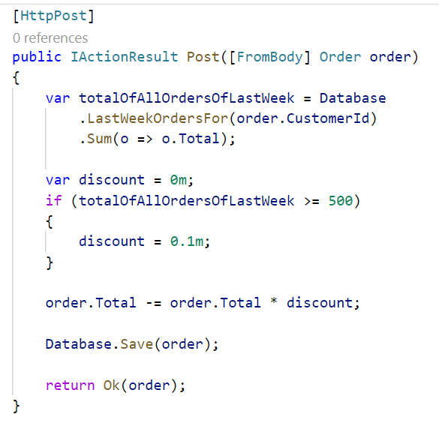
Notes:
Now this order object is implementing some.
I wouldn't call this complicated business logic,
but we got a new business requirement that says as
a part of processing.
A new order. We want to decide under which conditions
a customer is going to be getting a discount now.
The customer that is submitting this order in the past
week did more than $500 euros Swiss Francs Norwegian kroner Swedish kroner Danish kroner whatever your currency of
choices. Then they get a discount. And if not, they don’t.
Your average developer looks at the requirement implements this code doesn't really think twice checks that it works
The area where things become a little bit tricky is what happens if it’s 2 or more users.
But the customer in essence is an account and we can have multiple users from the same account buying stuff on the same account. So we have two or more users at the same time, both of them are submitting an order.
Run demo
Alright so imagine 2 threads going through that logic at the same time, where the last week of orders was $300.
Each of them is submitting a new $300 order.
Both of the logic goes down to the database. Both threads go to the database take a look at all of the existing orders.
Oh. No, we've only got $300 worth of orders

Slide 7
And then the customer walks into your office
Notes:
For one of the order the customer didn’t get a discount. You can imagine this gets worse the more concurrent requests we get from the same customer. Where if these users just made their requests a couple of seconds apart, then one of them would have gotten a discount.

Slide 8

Notes:
Now that's not a very nice thing to do when you think about it, I mean, ultimately, we are penalizing our users.
For this type of behavior for purchasing too quickly.

Slide 9
Notes:
How we ended up here to begin with?
So this idea about processing these types of things in
real time before that,
we had the good old solutions.
The ones that anytime. You need it to do any
kind of data crunching?
What did you do you wrote a batch job?

Slide 10
Frontend
Backend
Database
ASP.NET CORE
Front
Back
Storage
Orders
Read / Write
HTTP
ADO.NET
Scheduler
Notes:
Demo 2
Briefly explain
Switch to code

Slide 11
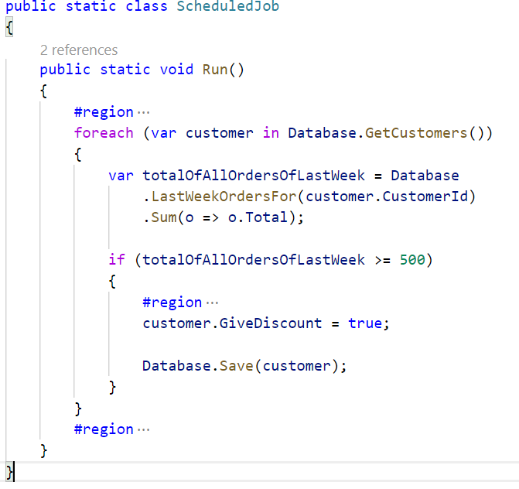

Slide 12
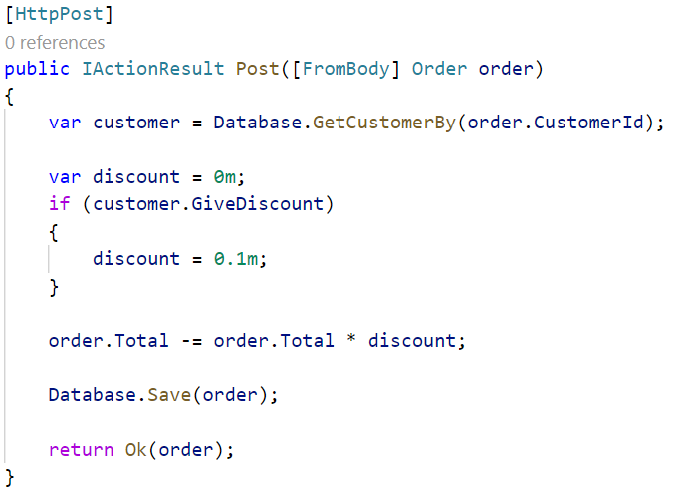

Slide 13
Thanks
Notes:
Thanks

Slide 14
Slides, Links…
github.com/danielmarbach/KnockKnock

Slide 15
Q & A

Slide 16

Software Engineer
Enthusiastic Software Engineer
Microsoft MVP
@danielmarbach
particular.net/blog
planetgeek.ch
Notes:
I’m Daniel, Solution Engineer…
I live in central Switzerland. If you want to know more about me listen to episode 77 of developer on fire
You can reach me on twitter under @danielmarbach
I blog on the particular blog and on my personal blog
I’m the lead behind the asyncification of NServiceBus and the ecosystem around it
I regularly contribute back ideas and code changes to asyncify the .NET OSS libraries and frameworks out there. So far I contributed to Entity Framework, RabbitMQ, Marten, MassTransit, Quartz.NET and many more

Slide 17
Thanks
Notes:
Thank you very much for listening and see you next time

